Slide 1
INTERNSHIP
PROJECTS

Slide 2
PROJECTS
Automated inventory Shelf Tracking System (QZ Lab)
Smart Shelf Based Inventory Monitoring System (Warranty Lab)
Development of UBAT Interface and Alternate Chamber Contact (QZ Lab)
Digital Spare Part Inventory Management System (Warranty Lab & QZ Lab)
Customer Scorecard Dashboard (CS Team)
Multimeter-Controlled ECU Passive Testing System (Warranty Lab)

Slide 3
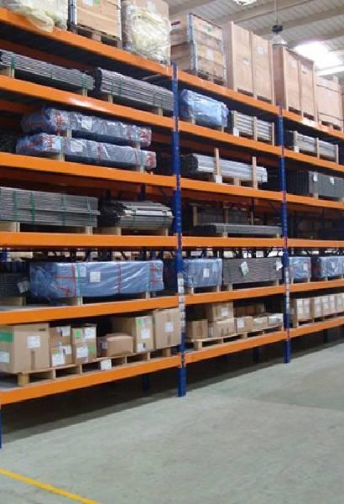
Automated inventory Shelf Tracking System
&
Smart Shelf Based Inventory Monitoring System

Slide 4
Feature / Aspect | Old Traditional System | New Shelf Management System
Tracking Method | Manual (writing boards, notes) | Digital (web-based inventory system)
Accessibility | Limited to physical location | Accessible anytime via website
Accuracy | Prone to human error | High accuracy with real-time updates
Update Speed | Slow and manual | Instant and automated
Searchability | Requires manual searching | Instant search by shelf ID, item, or category
Data Storage & History | No data backup or historical logs | Maintains logs and history of all changes
User Experience | Inconvenient and outdated | User-friendly dashboard and interface
Efficiency | Time-consuming sample tracking | Streamlined operations and improved productivity
Scalability | Difficult to scale with more items | Easily scalable for more shelves and items
Reporting & Insights | Not available | Real-time reports and insights available

Slide 5
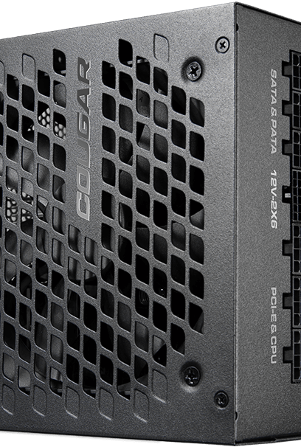
Development of UBAT Interface and Alternate Chamber Contact

Slide 6
Feature / Aspect | T15 | Chamber Contact
Definition | A switched power line (typically +12V) that is only active when the ignition or master switch is ON. | A physical switch/contact usually triggered by the position/state of a door, cover, or enclosure.
Primary Function | Acts as a system-wide signal for “ignition ON” or “system active” status. | Acts as a state detector (e.g., door open/closed) or a manual trigger for internal override.
Typical Use Case | Enable systems only when ignition is ON (e.g., relays, controllers, or timer circuits). | Detect if a chamber (door/cover) is closed, or allow a user to operate a switch from inside.
Trigger Mechanism | Voltage-based (e.g., 12V when ignition ON). | Mechanical contact or push-switch.
Integration Level | Often hardwired into the vehicle or device's electrical system. | Usually mounted on physical components (doors, covers, etc.).
Manual Control | No direct user interface — passive signal. | Often user-accessible (e.g., inside pushbutton).
Safety Role | Prevents system operation when ignition is OFF. | Ensures physical access control or allows safe internal override.
Failsafe Behavior | Depends on upstream fuse/relay. | Often designed to default to a known state (e.g., open = system off).
Common Applications | Relay enable, power gating, ECU activation. | Safety interlocks, internal emergency release, position sensing.
Voltage Type | Electrical signal (12V typically). | Contact closure (usually logic-level or grounded).

Slide 7
Digital Spare Part Inventory Management System

Slide 8
Feature / Aspect | Old Traditional System | New Spare Part Management System
Tracking Method | Manual logs, paper registers | Digital (Power Apps / Web-based inventory system)
Accessibility | Restricted to physical location and person | Accessible from mobile, desktop, or cloud
Accuracy | Error-prone due to manual entry | High accuracy with input validation and automation
Update Speed | Delayed updates; batch entry at end of day | Real-time updates as transactions occur
Searchability | Hard to find parts or status quickly | Instant search with filters by ID, name, location
Inventory Visibility | Lack of overall picture on stock levels | Clear dashboard with stock status and alerts
Stock Alerts / Notifications | Not available or delayed | Automatic low-stock or reorder notifications
User Experience | Paper-heavy, time-consuming | Intuitive interface with dropdowns and checkboxes
Efficiency | Manual errors, time lost in locating parts | Faster issue resolution and fewer missing items
Reporting & Analytics | No historical trends or insights | Downloadable reports, charts, usage trends
Spare Part Lifecycle Tracking | Not tracked | Tracks issue date, user, return, or disposal info
Security & Access Control | Anyone with logbook can make changes | Role-based access (Admin, Technician, Viewer)
Scalability | Not scalable for growing inventory | Easily handles large number of parts and users

Slide 9

Customer Scorecard Dashboard

Slide 10
Individual Customer Profiles
Designed dynamic interfaces to display personalized data for each customer including name, ID, order history, and contact info.
Interactive Dashboard Widgets
Implemented real-time widgets showing active orders, pending requests, notifications, and part status with responsive UI elements.
Search and Filter Capabilities
Developed advanced search bar and filters allowing users to quickly find parts, orders, or issues specific to a customer.
Role-Based Access Views
Created custom layouts and permissions for different user roles (Admin, Technician, Customer), ensuring tailored access and display.
Responsive and Mobile-Friendly UI
Built the dashboard using modern front-end frameworks (e.g., React/Bootstrap) to ensure smooth user experience across all devices.

Slide 11

Multimeter-Controlled ECU Passive Testing System

Slide 12
Automated Relay Switching via Controller
Developed a system where the controller dynamically switches 102 relays per ECU based on pin status, eliminating manual intervention.
Real-Time Multimeter Integration
Integrated multimeter readings (voltage, current, continuity) with the controller logic to verify signal integrity before triggering relays.
Pin-to-Relay Mapping Logic
Designed software architecture that maps each ECU pin to its respective relay with status tracking for real-time diagnostics and feedback.
Fault Detection and Isolation
Implemented error-checking routines to detect anomalies (e.g., overcurrent, missing voltage) and isolate faulty relays or pins automatically.
Modular & Scalable Design
System designed to support multiple ECUs and scalable up to hundreds of relays, with easy configuration through a centralized control interface.

Slide 13
Progress REPORT [30TH MAY 2025]
Project | Measurement | Target | Achieved
Automated inventory Shelf Tracking System | Percentage (%) | 100 | 100
Smart Shelf Based Inventory Monitoring System | Percentage (%) | 100 | 100
Development of UBAT Interface and Alternate Chamber Contact | Percentage (%) | 100 | 100
Digital Spare Part Inventory Management System | Percentage (%) | 100 | 85
Customer Scorecard Dashboard | Percentage (%) | 100 | 90
Multimeter-Controlled ECU Passive Testing System | Percentage (%) | 100 | 100

Slide 14
Thank you
Malhar Kulkarni(Intern QZ LAB)
8792207579
malharskulkarni20@gmail.com

